Slide 1
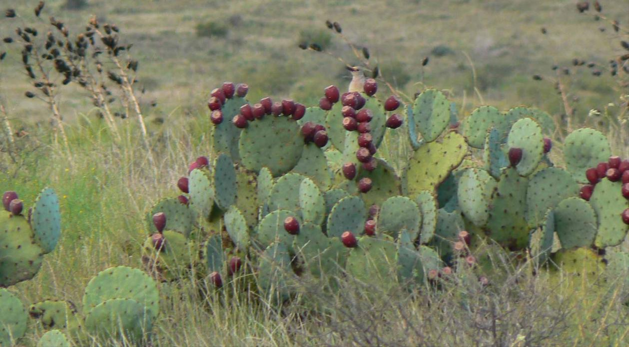
Texas Ecoregions

Slide 2
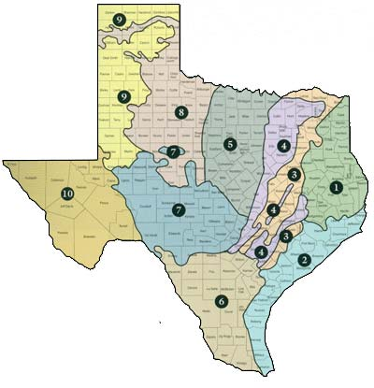
Texas Ecoregions
1 − East Texas Pineywoods
2 – Gulf Coast Prairies and
Marshes
3 – Post Oak Savannah
4 – Blackland Prairies
5 – Cross Timbers and
Prairies
6 – South Texas Plains
7 – Edwards Plateau
8 – Rolling Plains
9 – High Plains
10 – Trans Pecos West Texas
Texas Parks and Wildlife Department

Slide 3
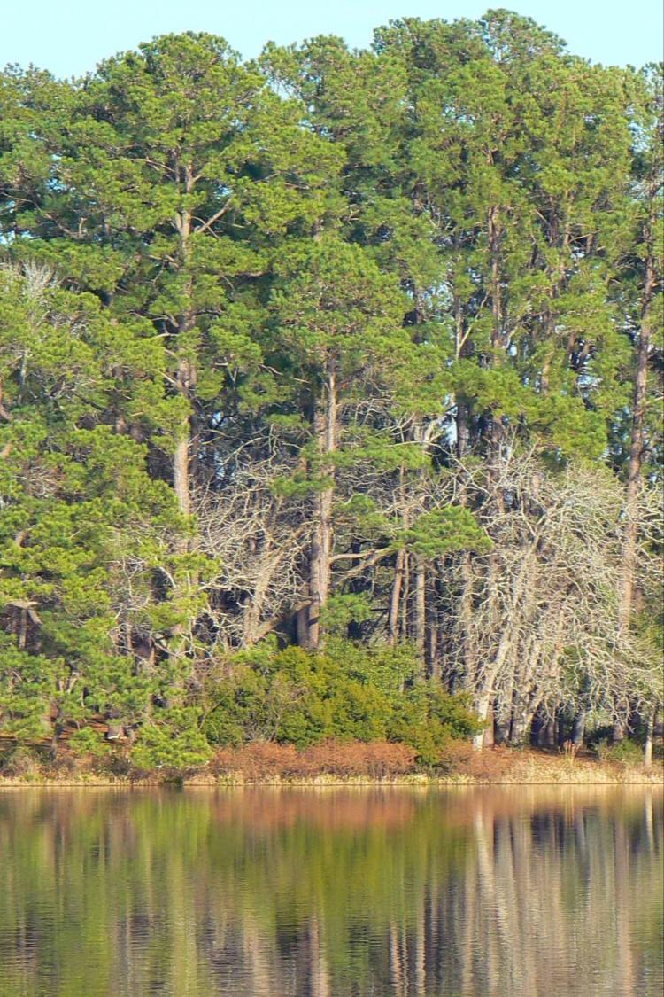
Ecoregion 1 East Texas Pineywoods Habitats Mixed Pine & Hardwood Forests, Swamps, Freshwater Lakes, Rivers & Streams

Slide 4
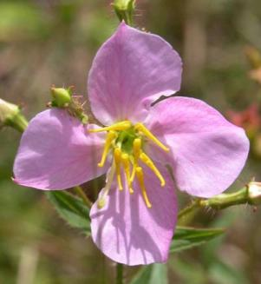
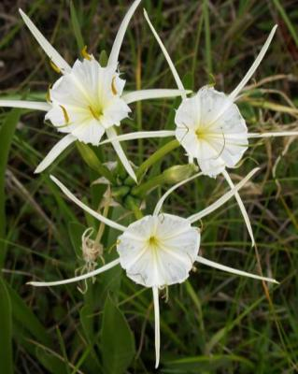
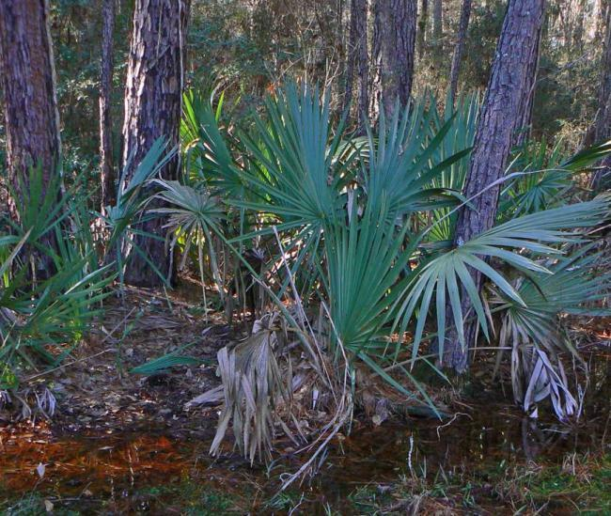
East Texas Plants

Slide 5
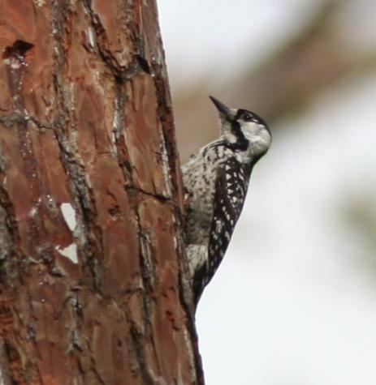
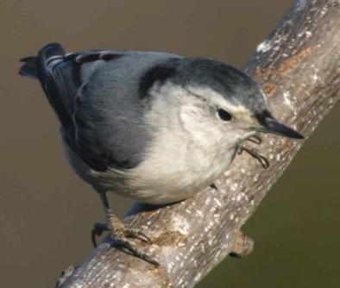
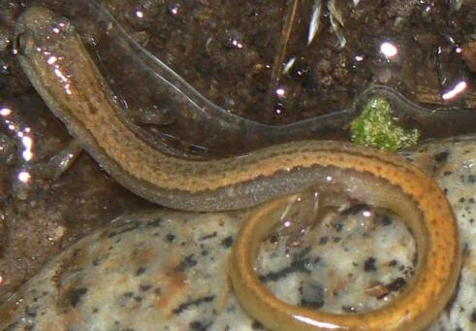
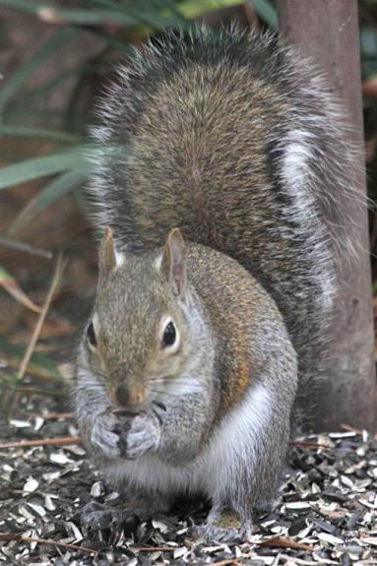
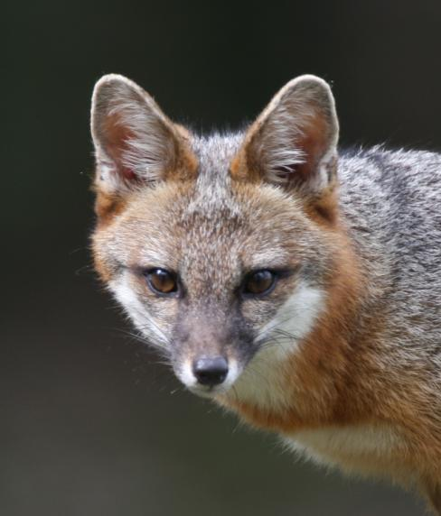
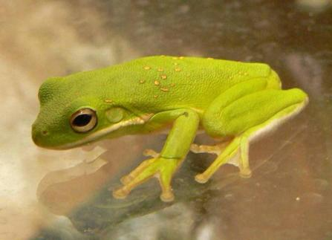
East Texas Wildlife

Slide 6
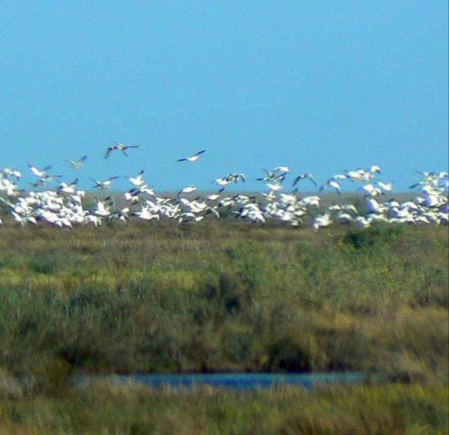
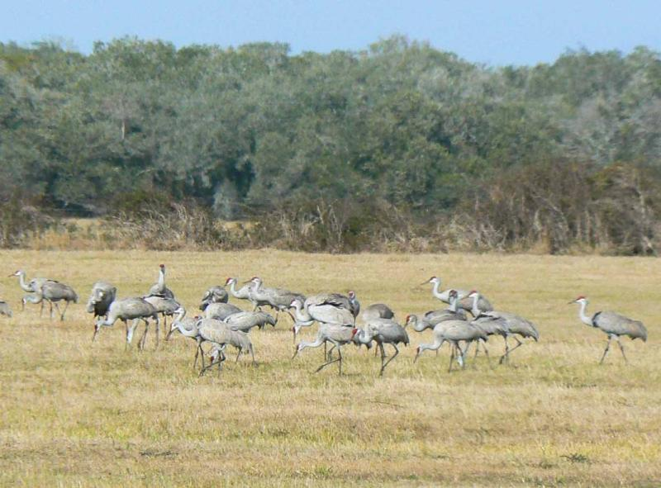
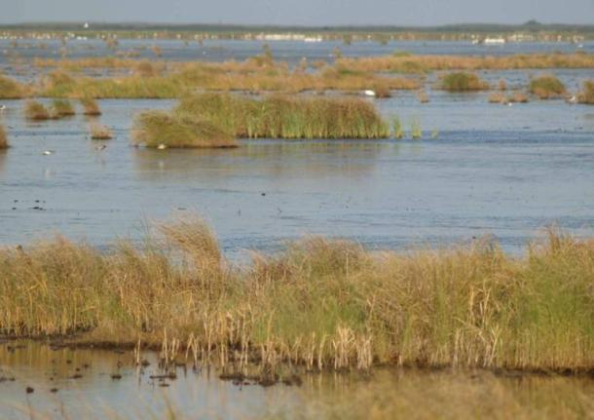
Ecoregion 2 Gulf Coast Prairies & Marshes Habitats Prairies, Marshes, Live Oak Mottes

Slide 7
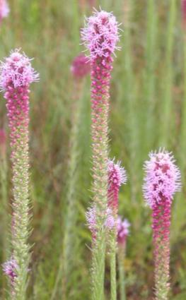
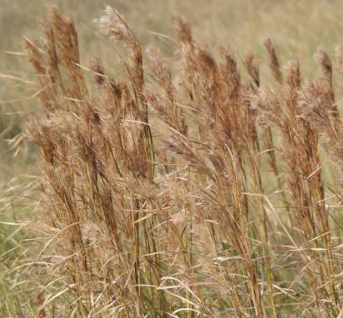
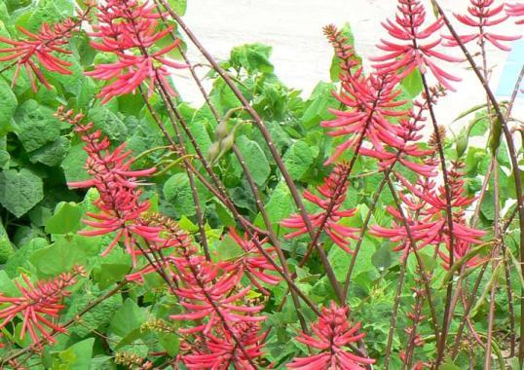
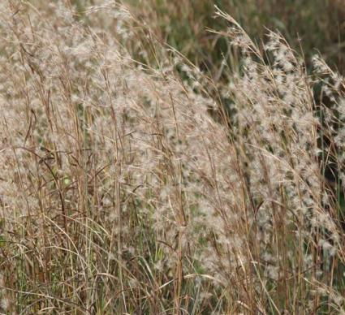
Coastal Prairies & Marshes Plants

Slide 8
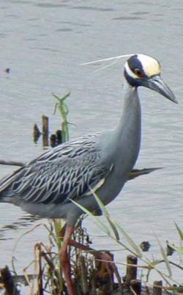
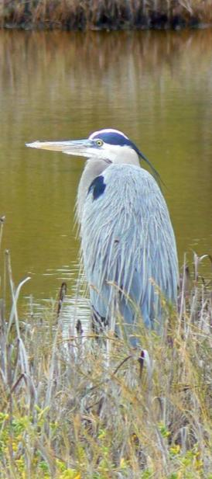
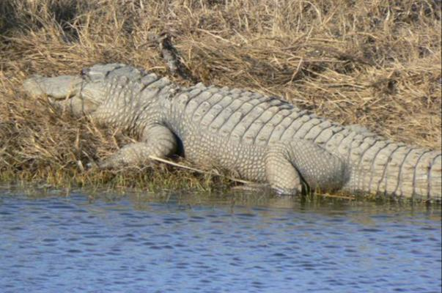
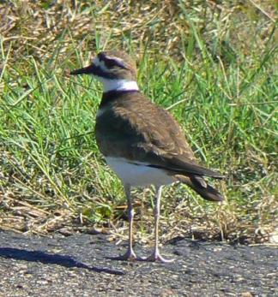
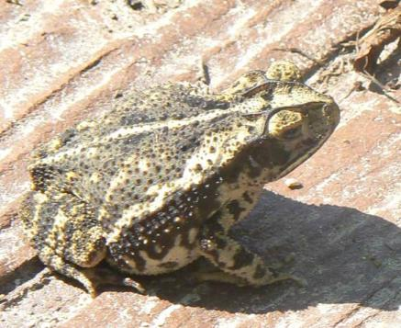
Coastal Prairies & Marshes Wildlife

Slide 9
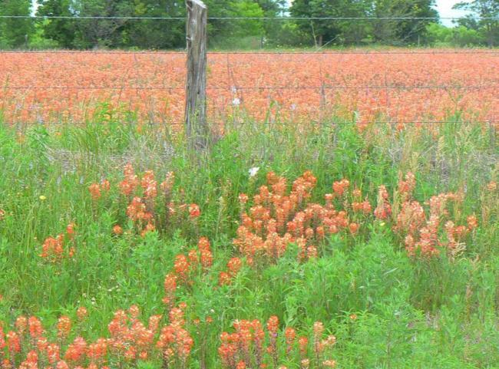
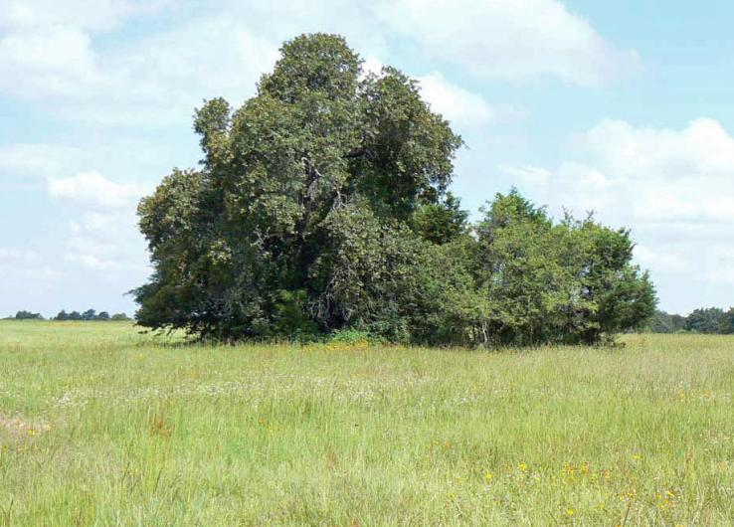
Ecoregion 3 Post Oak Savannah Habitat Prairie & Post Oak Mix with Grasses Dominant

Slide 10
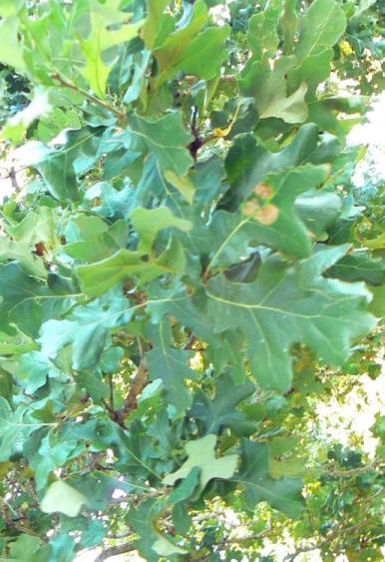
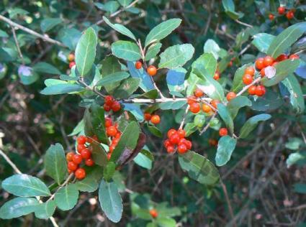
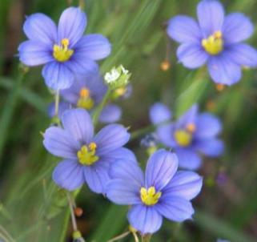
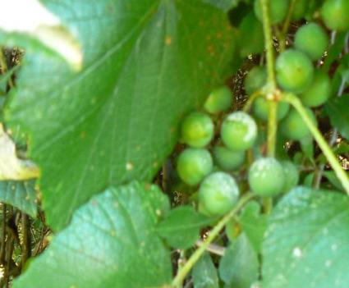
Post Oak Savannah Plants

Slide 11
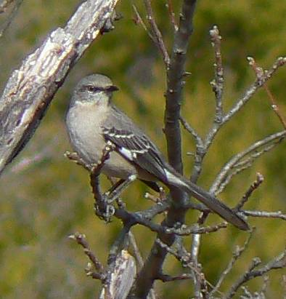
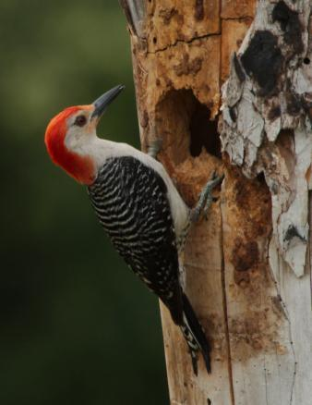
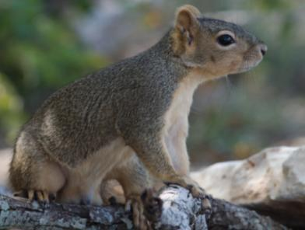
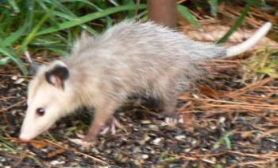
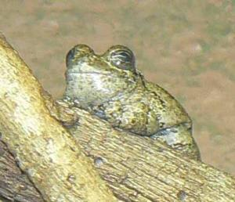
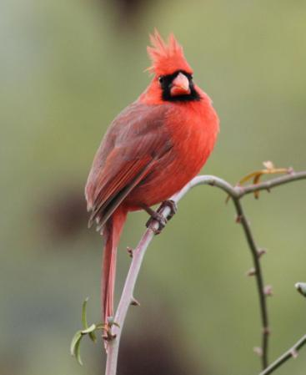
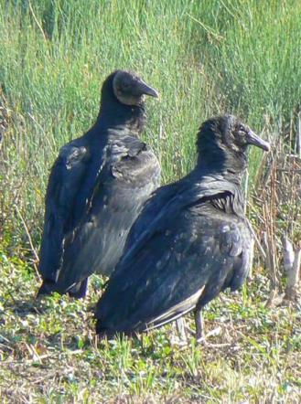
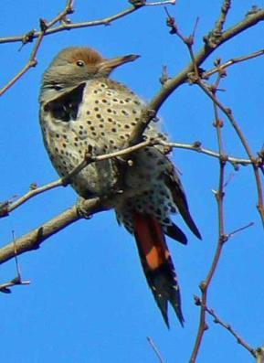
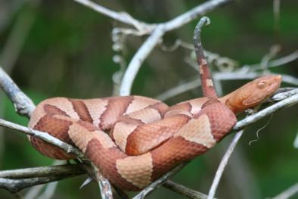
Post Oak Savannah Wildlife

Slide 12
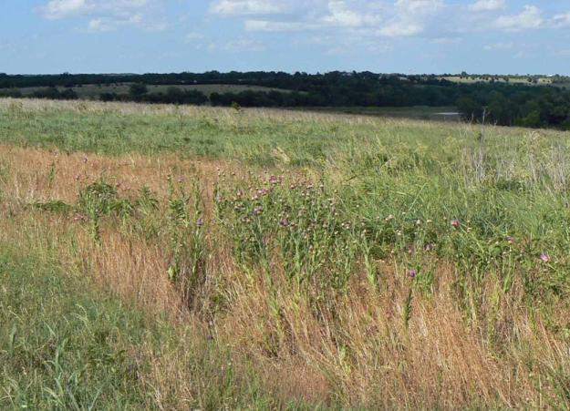
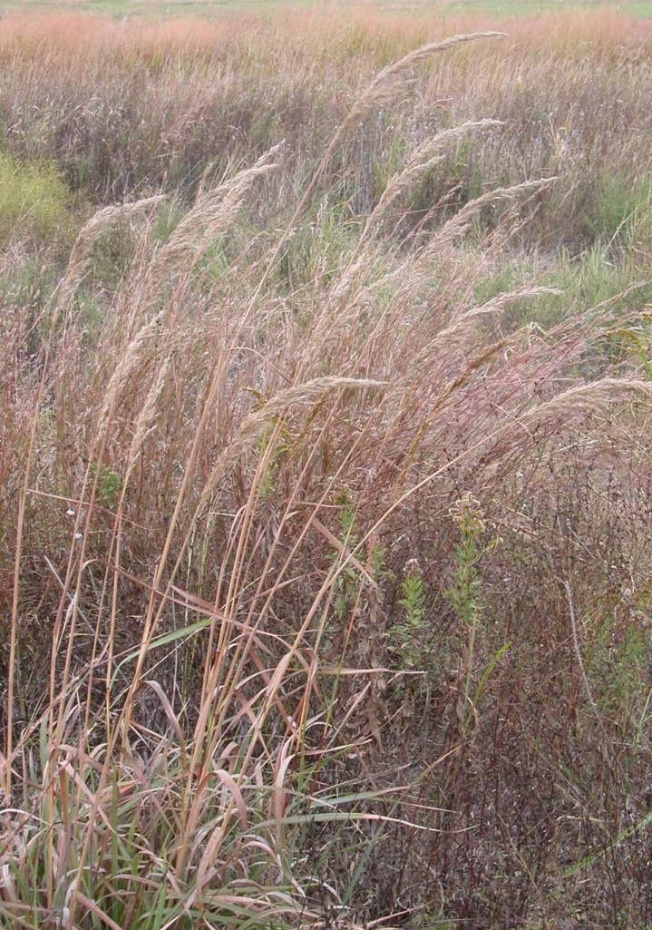
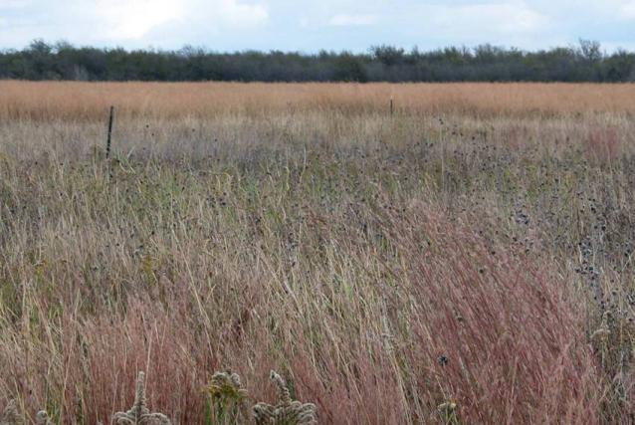
Ecoregion 4 Blackland Prairie

Slide 13
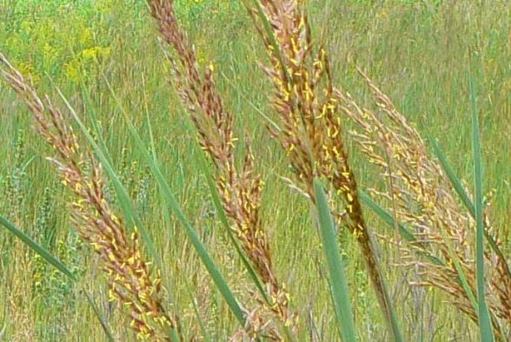
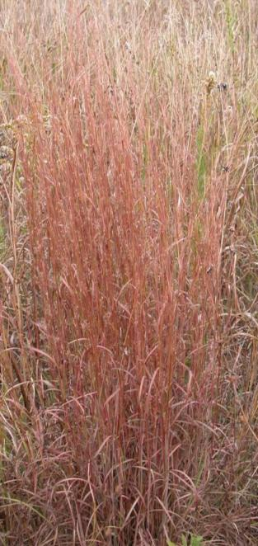
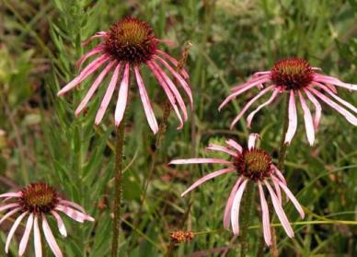
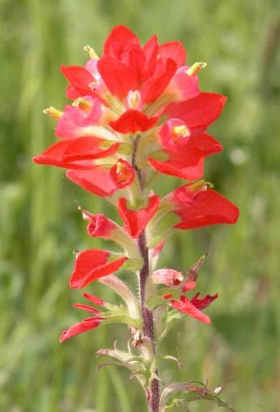
Blackland Prairie Plants

Slide 14
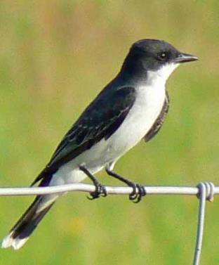
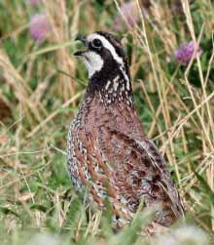
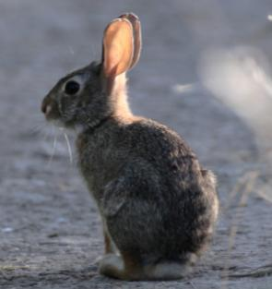
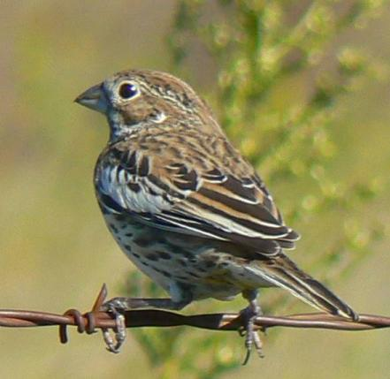
Blackland Prairie Wildlife

Slide 15
Ecoregion 5 Cross Timbers & Prairies

Slide 16
Cross Timbers & Prairies Plants

Slide 17
Cross Timbers & Prairies Wildlife

Slide 18
Ecoregion 6 South Texas Plains

Slide 19
Plants of the South Texas Plains

Slide 20
Wildlife of the South Texas Plains

Slide 21
Ecoregion 7 Edwards Plateau

Slide 22
Plants of the Edwards Plateau

Slide 23
Wildlife of the Edwards Plateau

Slide 24
Ecoregion 8 Rolling Plains

Slide 25
Plants of the Rolling Plains

Slide 26
Wildlife of the Rolling Plains

Slide 27
Ecoregion 9 High Plains

Slide 28
Plants of the High Plains

Slide 29
Wildlife of the High Plains

Slide 30
Ecoregion 10 Trans Pecos

Slide 31
Plants of the Trans Pecos

Slide 32
Wildlife of the Trans Pecos

Slide 33
Name & match the species to their ecoregions

Slide 34
Photos by Pat and Nicole Merkord Mandi Haller, and Eric Rundfeldt
Funding to develop these instructional resources was provided by Texas Parks and Wildlife Department contract #409330 and U. S. Fish and Wildlife Service Section 6 grant TX E-133-R

Slide 35
Alignment
*Alignment is provided for English Language Arts and Reading, Mathematics, Science and Social Studies where applicable and color-coded for each grade level.
Grade 3 (red)
Grade 4 (blue)
Grade 5 (green)
Grade 6 (purple)
English Language Arts & Reading student expectations: 3, 4(A,B); 1, 2(A,B), 13(B); 1, 2(A,B), 13(B); 1, 2(A,B), 12(B)
Mathematics student expectations: N/A
Science student expectations: 3(A), 7(C), 9(A); 3(A), 7(B); 3(A), 7(B), 9(A); 3(A), 12(E,F)
Social studies student expectations: 4(A), 5(C,D), 17(E); 6(A), 7(B), 21(A-C), 22(A); 6(A), 7(B), 24(A-C), 25(A); 3(A), 4(D), 21(A-C), 22(A)
Funding to develop these instructional resources was provided by Texas Parks and Wildlife Department contract #409330 and U. S. Fish and Wildlife Service Section 6 grant TX E-133-R

